Slide 1
Android Development Tech Share
QR code reader with ZXing
Qiming Xu
xu.qim@husky.neu.edu
11/20/2019
Notes:
Qiming Xu

Slide 2
About ZXing
ZXing (“zebra crossing”) is a barcode image processing library implemented in Java, with ports to other languages. It has support for 1D product, 1D industrial, and 2D barcodes.
ZXing is used by web search to make millions of barcodes on the web indexable. It also forms the basis of Android’s Barcode Scanner app and is integrated into Google Product and Book Search.
Github repo: https://github.com/zxing/zxing

Slide 3
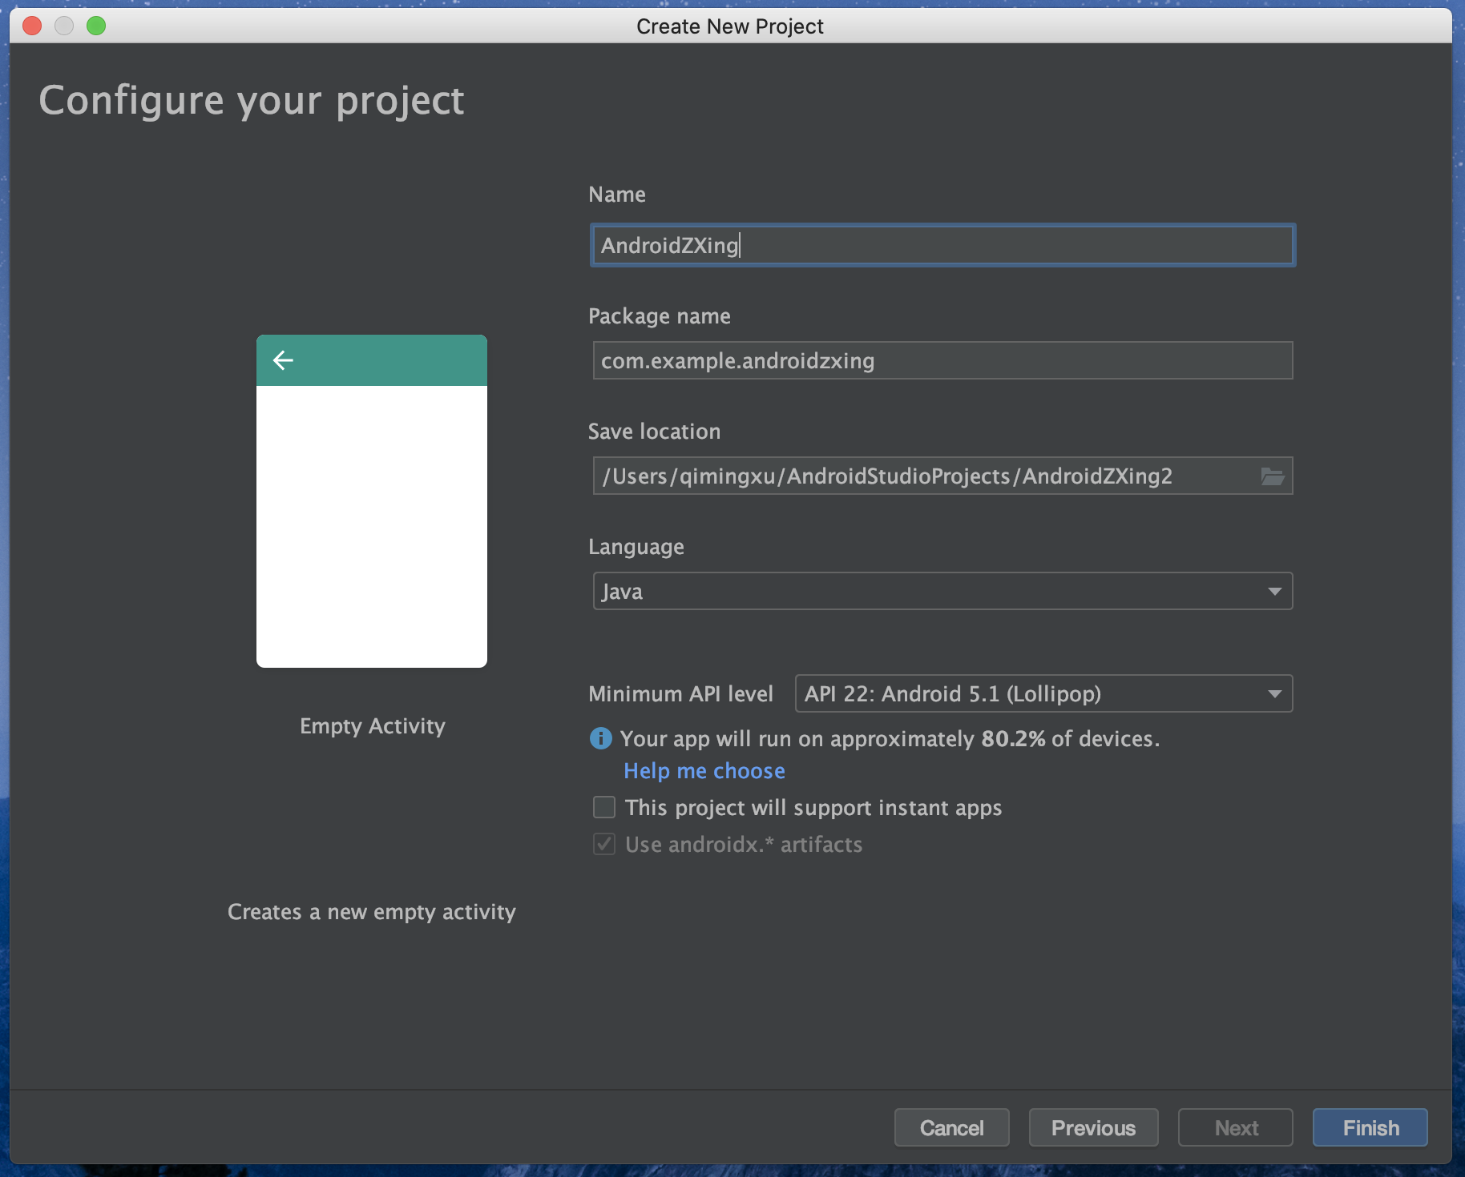
First, create new project

Slide 4
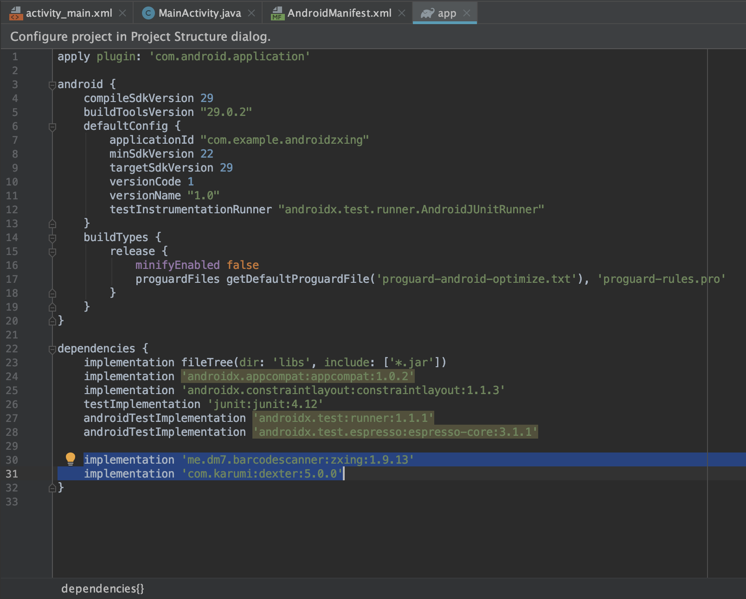
Install new libraries

Slide 5
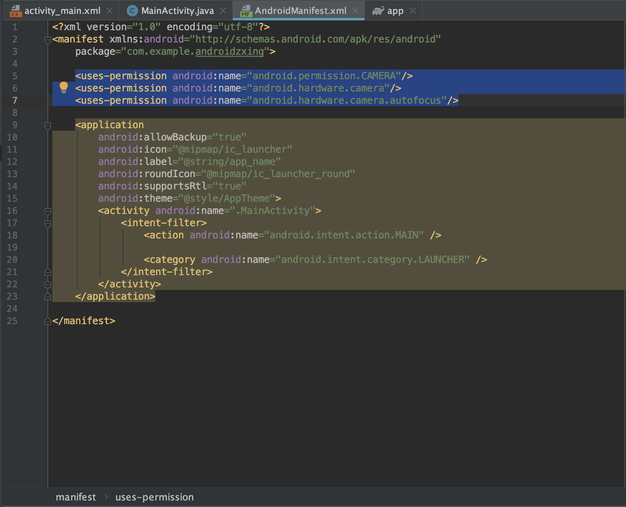
Declare permission

Slide 6
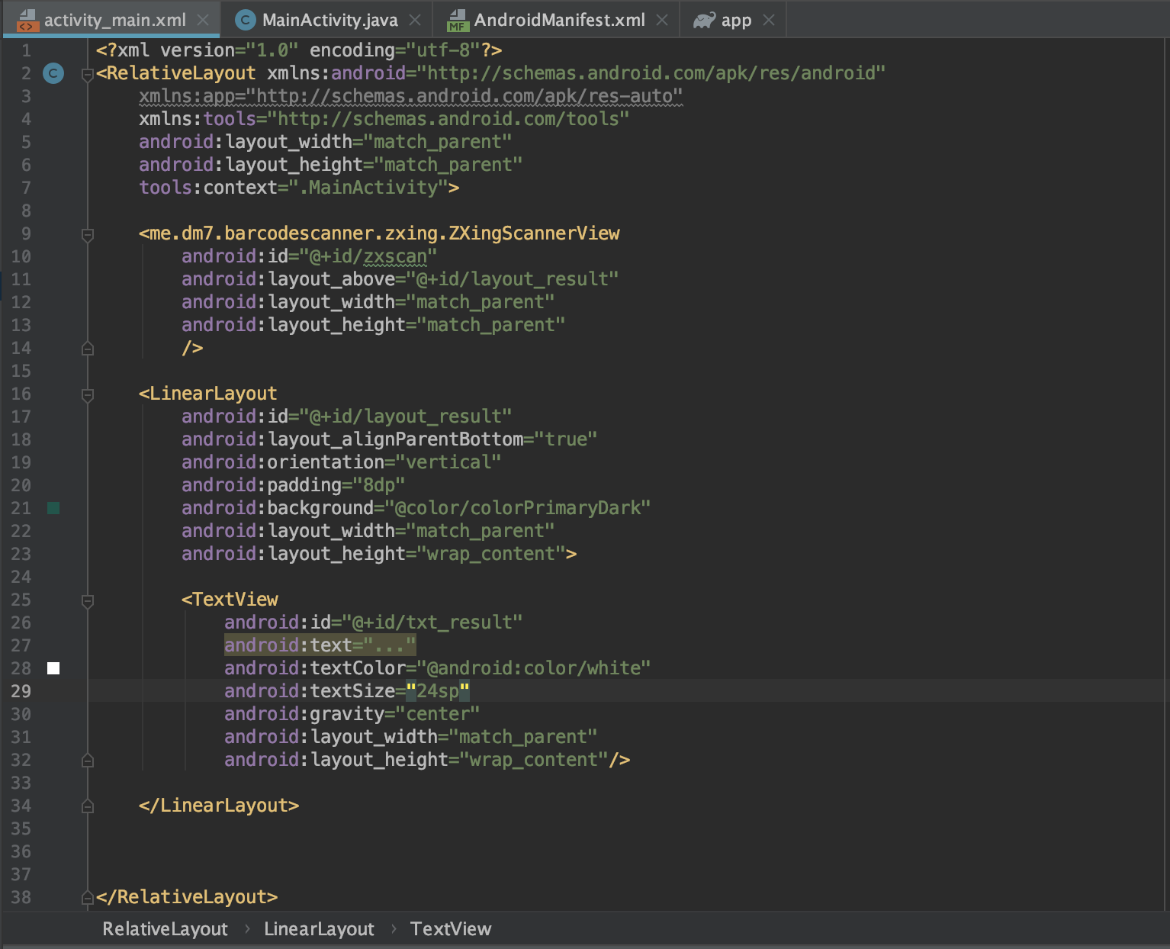
Design the UI

Slide 7
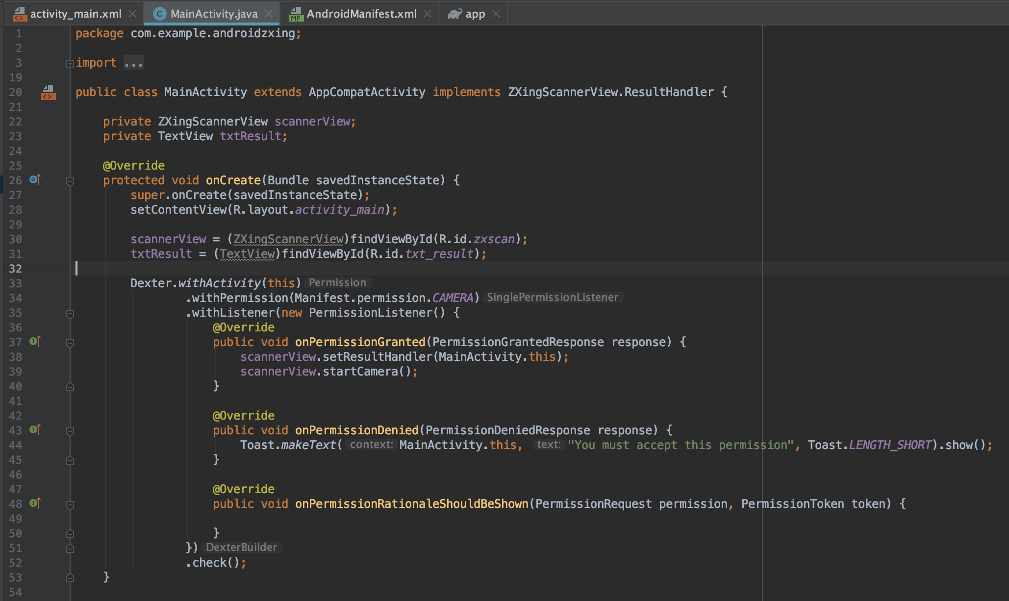
Grant permission when APP start

Slide 8
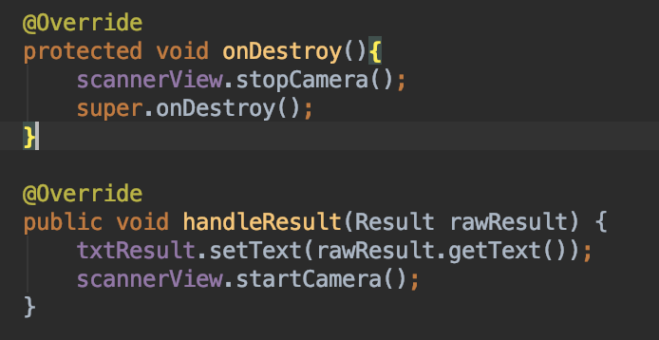
Handle the result and stop camera when APP quit

Slide 9
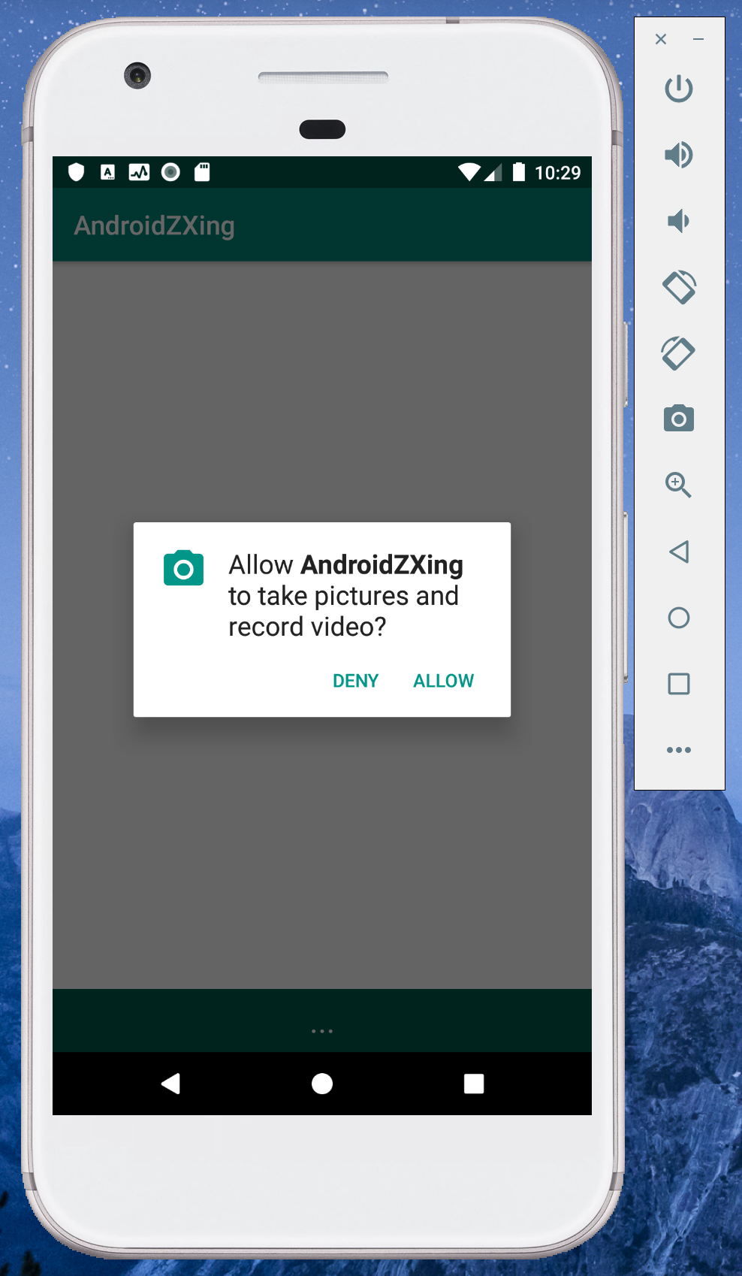
Allow camera
permission

Slide 10
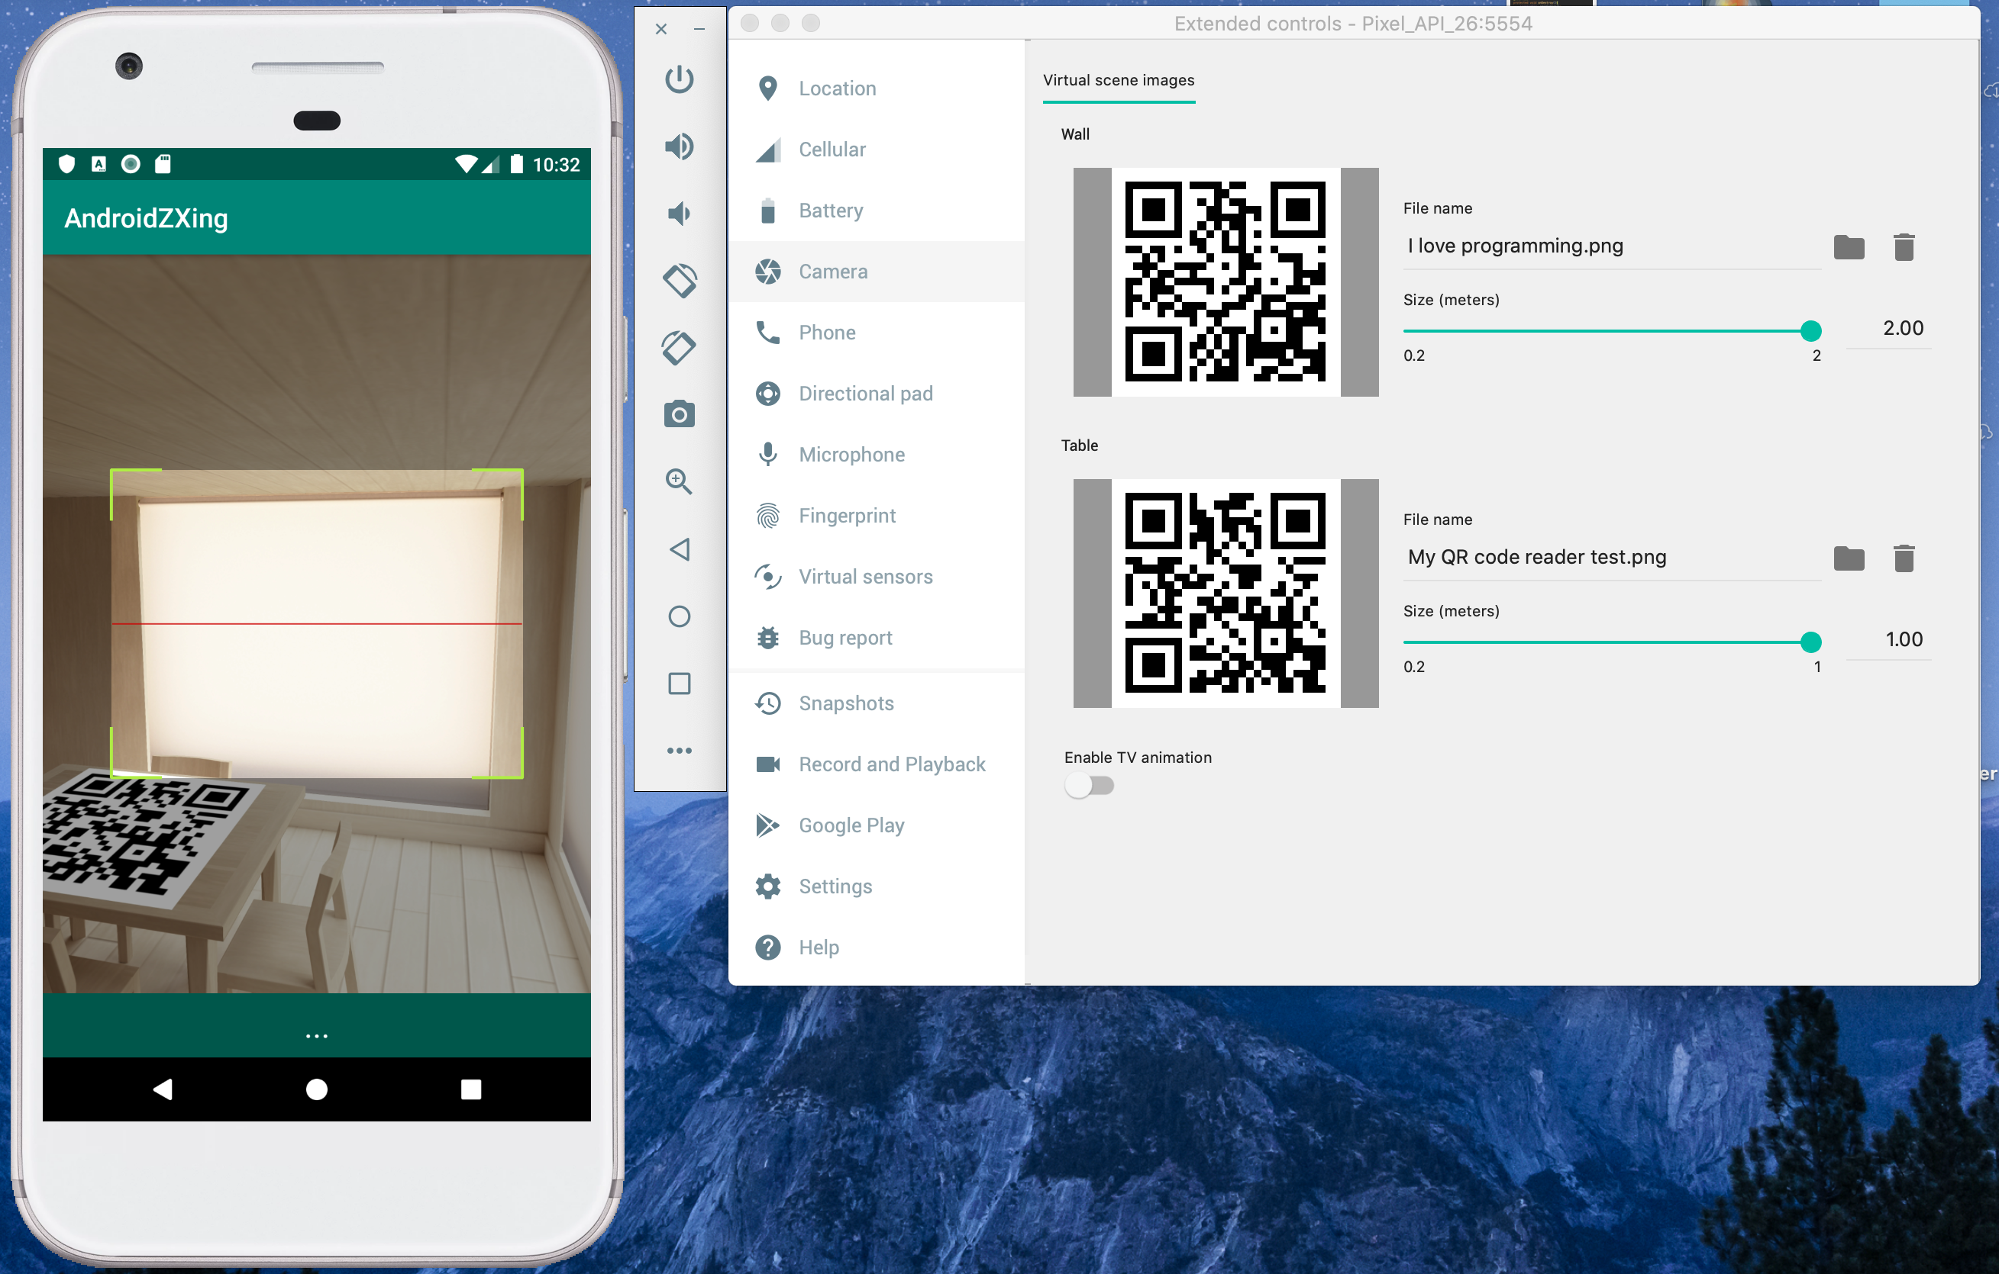
Add test images

Slide 11
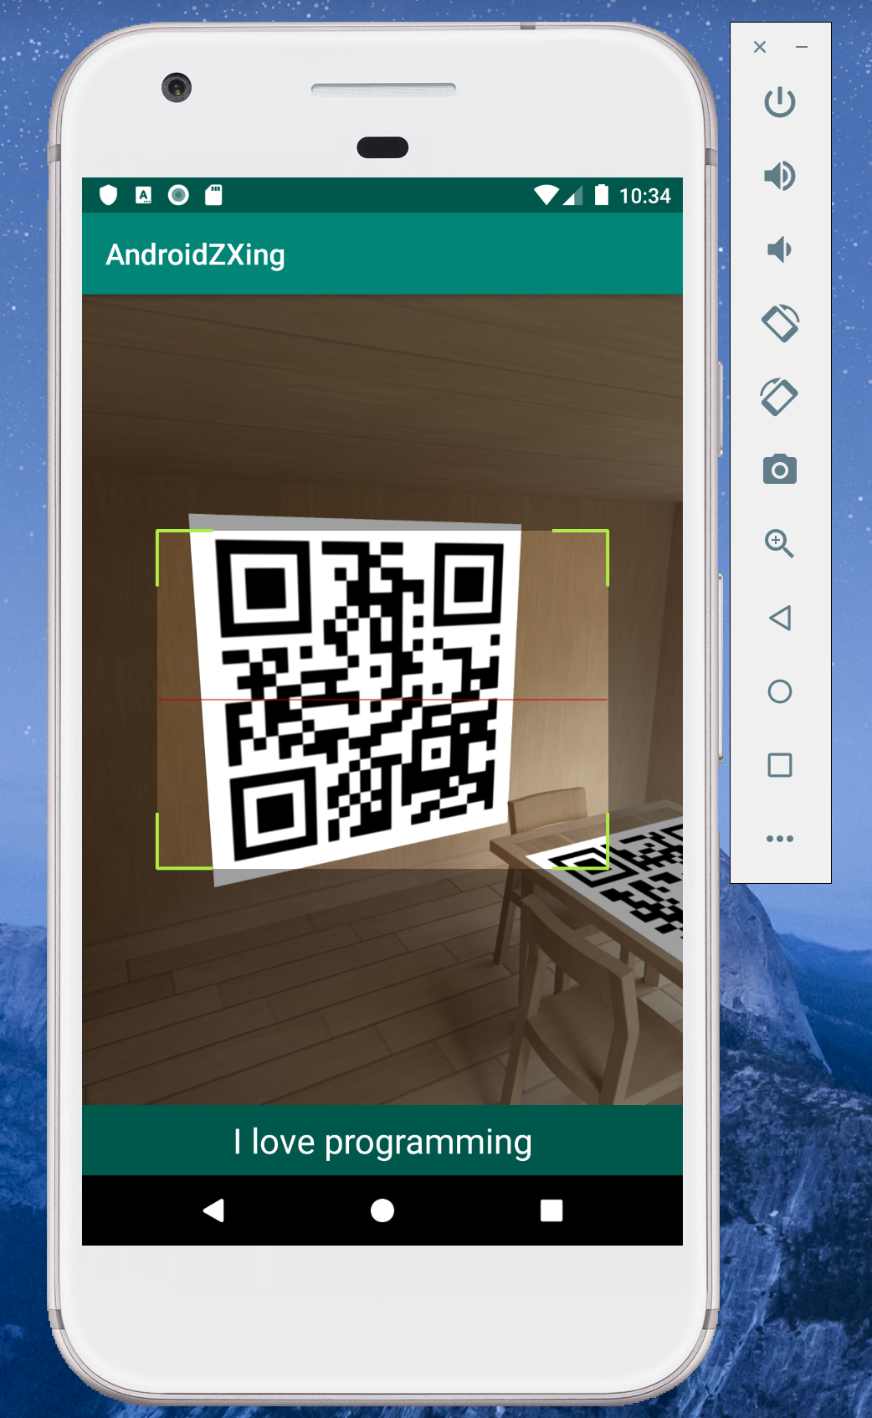
Test Result:

Slide 12
Thank You!

